Slide 1
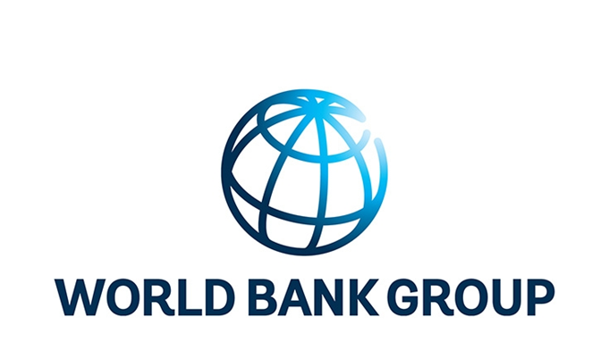
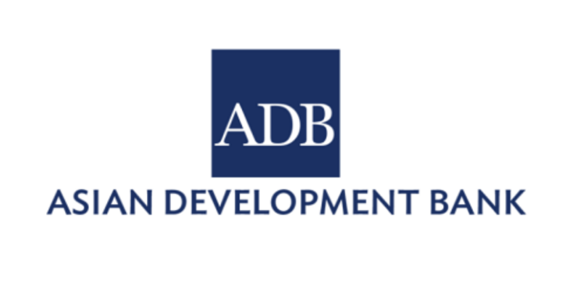

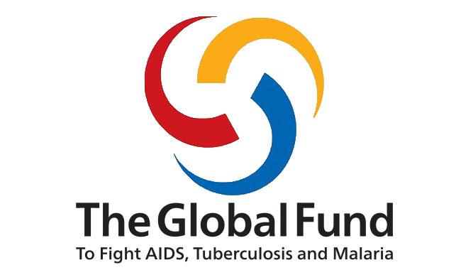


NAVIGATING TRANSITIONS Challenges, opportunities, and policy options Session # Global Flagship Course on Health Systems Strengthening: The Challenge of Universal Health Coverage – ARMENIA SARAH ALKENBRACK ͣ, TOOMAS PALU ͣ, CLEMENTINE MURER ͣ, SANTIAGO CORNEJO ᵇ ͣHealth Nutrition and Population Global Practice, World Bank ᵇ Gavi, the Vaccine Alliance

Slide 2


How to navigate transitions?
Notes:
Key message: Sometimes we need a little help when getting to our destination……all of us are here to discuss strategies for reaching UHC. But along the way we are going to encounter many roadblocks and will have to NAVIGATE many transitions. This is the purpose of the presentation – to bring attention to these transitions that we will navigate along the road to UHC and in doing so, be better able to plan for them.

Slide 3
Outline
1
Review transitions affecting health
Understand why “paying attention” to transitions is essential for making progress towards UHC
2
Discuss challenges and opportunities faced by transition from development assistance
3
Notes:
3rd point: globally and in armenia

Slide 4

Demographic Transition
The transition from high birth and high mortality rates to lower birth and lower mortality rates as a country develops economically.
- Thompson, 1929
Notes:
Proposed in 1929 by american demographer warren thompson
Any demographers in the room?

Slide 5
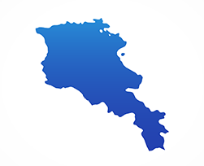
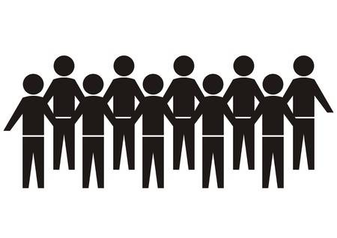




Armenia’s population structure is changing
Increasing life expectancy
Decreasing fertility rates
Decreasing population
1960 – 63 years → 2017 – 71 years
1960 – 4.8
2017 – 1.6
2.93 million people (2017)
1960 – 69 years → 2017 – 78 years
Notes:
Life expectancy has increased, and we see higher LE among females than males
Fertility rate has decreased from a country with relatively high fertility to one with low fertility – now below the replacement level (1.612 in 2016)
Armenia has a population of around 3 million people (2,930,450 in 2017)
Total population has been decreasing since the late 1990s and is expected to decrease in the future
Source: United Nations, Department of Economic and Social Affairs, Population Division (2017). World Population Prospects: The 2017 Revision, Online Demographic Profiles. Available from https://population.un.org/wpp/Graphs/DemographicProfiles/, Accessed on April 28, 2019.

Slide 6
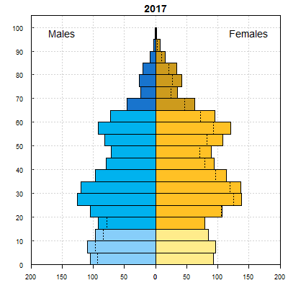
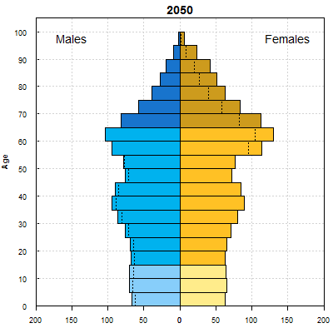
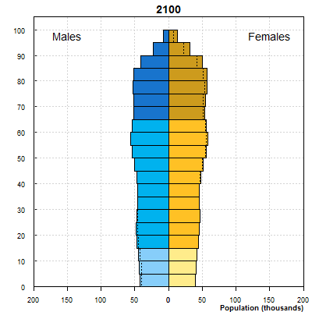
Changes in Armenia's demographic profile will have implications on all sectors, including health
Low fertility, ageing and migration lead to significant impacts on economy and health spending patterns
Implications on health sector include: reduced workforce, revenue mobilization for health sector, and disease profile (including transmission of HIV and MD-TB) and increasing cost of services.
Notes:
Emphasize…
The country faces significant demographic challenges that will impact the economy and health spending patterns.
Population aged 65 years + is expected to double from 10% to almost 20 % by 2030
The aging population will add more pressure on the health system - success story
WBG paper, Rose.
Source of data: United Nations, Department of Economic and Social Affairs, Population Division (2017). World Population Prospects: The 2017 Revision, Online Demographic Profiles. Available from https://population.un.org/wpp/Graphs/DemographicProfiles/, Accessed on 29 March 2019.

Slide 7

Epidemiological Transition
Changing patterns of population age distributions, mortality, fertility, life expectancy, and causes of death. - McKeown, 2009
Notes:
Do we have doctors in the room? So you probably have seen these changes in your lifetime…

Slide 8


Armenia’s burden of disease has shifted and is now dominated by NCDs
Burden of Disease, Armenia (% of total DALYs)
1990
2017
Notes:
We will cover this in the remaining sessions but it’s something to keep in mind. We know that 84% of the disease burden is due to NCDs.
But infectious disease – also needs to be maintained……
NCDs account for 93% of deaths and 84% of disability-adjusted life years (DALYs) in 2016 (IHME, 2017)
May want to have someone explain disability adjusted life year....
One DALY can be thought of as one lost year of "healthy" life. The sum of these DALYs across the population, or the burden of disease, can be thought of as a measurement of the gap between current health status and an ideal health situation where the entire population lives to an advanced age, free of disease and disability. DALY= YLL + YLD YLL: Years of Life Lost
YLD: Years lost due to disability YLL= N x L N: Number of deaths L: standard life expectancy at age of death in years
YLD: I x DL x L I: number of incident cases
DW: disability weight L: average duration of the case until remission or death (years)

Slide 9



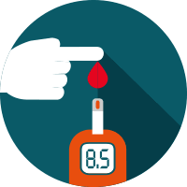

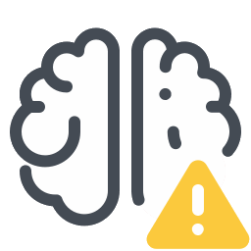
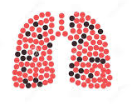

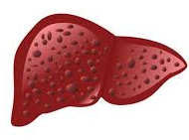


The following conditions contribute most to disease burden in Armenia, 1990 & 2017
Share of DALYs lost, 1990 & 2017
Ischemic heart disease 11.6% →16.9%
Neonatal disorders 10.2% → 2.4%
Lung cancer 2.1% → 3.2%
Diabetes mellitus 2.6% → 5.7%
Chronic obstructive pulmonary disease 2.5% → 2.8%
Stroke 5.0% → 5.6%
Low back pain 2.7% → 4.2%
Cirrhosis and other chronic liver diseases 1.1.% → 2.7%
Headache disorders 2.1% → 2.6%
Falls 2.5% → 2.0%
Notes:
+Share of DALYs lost due to many NCDs has increased
+Share of DALYs lost due to neonatal mortality decreased from 10.2% in 1990 to only 2.4% in 2017
+We will discuss implications of this disease burden throughout the course but the main take-away is that NCDs are on the rise; addressing this requires a people centered “integrated care” system that combines primary health care services with more advanced care for specific health conditions

Slide 10



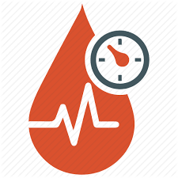
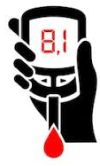


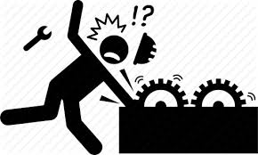
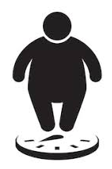
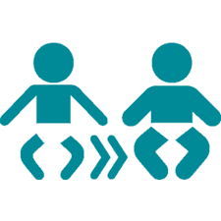
Top ten risk factors contributing to disease burden,
Armenia, 1990 & 2017
Share of DALYs lost, 1990 & 2017
High LDL cholesterol 5.6% → 7.6%
Dietary risks 14.4% → 18.1%
High systolic blood pressure 12% → 16.7%
Air pollution 7.9% - 6.8%
High fasting plasma glucose 9.3% → 16.3%
Impaired kidney function 2.2% → 3.6%
Tobacco 13.7% → 16.3%
Occupational risks 2.7% → 3.4%
High body-mass index 5.6% → 11.8%
Child and maternal malnutrition 16.8% → 3.2%
Notes:
But many of these risk factors for disease go beyond the health sector ……..dietary….
Need to think about policies that affect health beyond just health sector reforms
DALYs (1,000) 615.2 → 480.2
DALYs per 100,000 - 17,990 → 15,864
Important to think about this…….

Slide 11

Smoking rates in Armenia
Smoking prevalence
Higher among males
Average age started
(smoking years)
49.9%
17.9
1 out of every 2 men in Armenia smoke
1.6%
25.8
Notes:
Source: UHC indicators- STEPS data
How is this being addressed? Policies and efforts likely extend beyond health sector.. – education, food industry, agriculture, etc.
Not sure where armenia is on the use of sin taxes….ajay will cover

Slide 12

Health financing transition
An increase in the level of total health expenditures accompanied by a rise in the prepaid/pooled share of total health expenditure, experienced as country income increases
- Fan and Savedoff, 2015
Notes:
McKeown, 2009

Slide 13
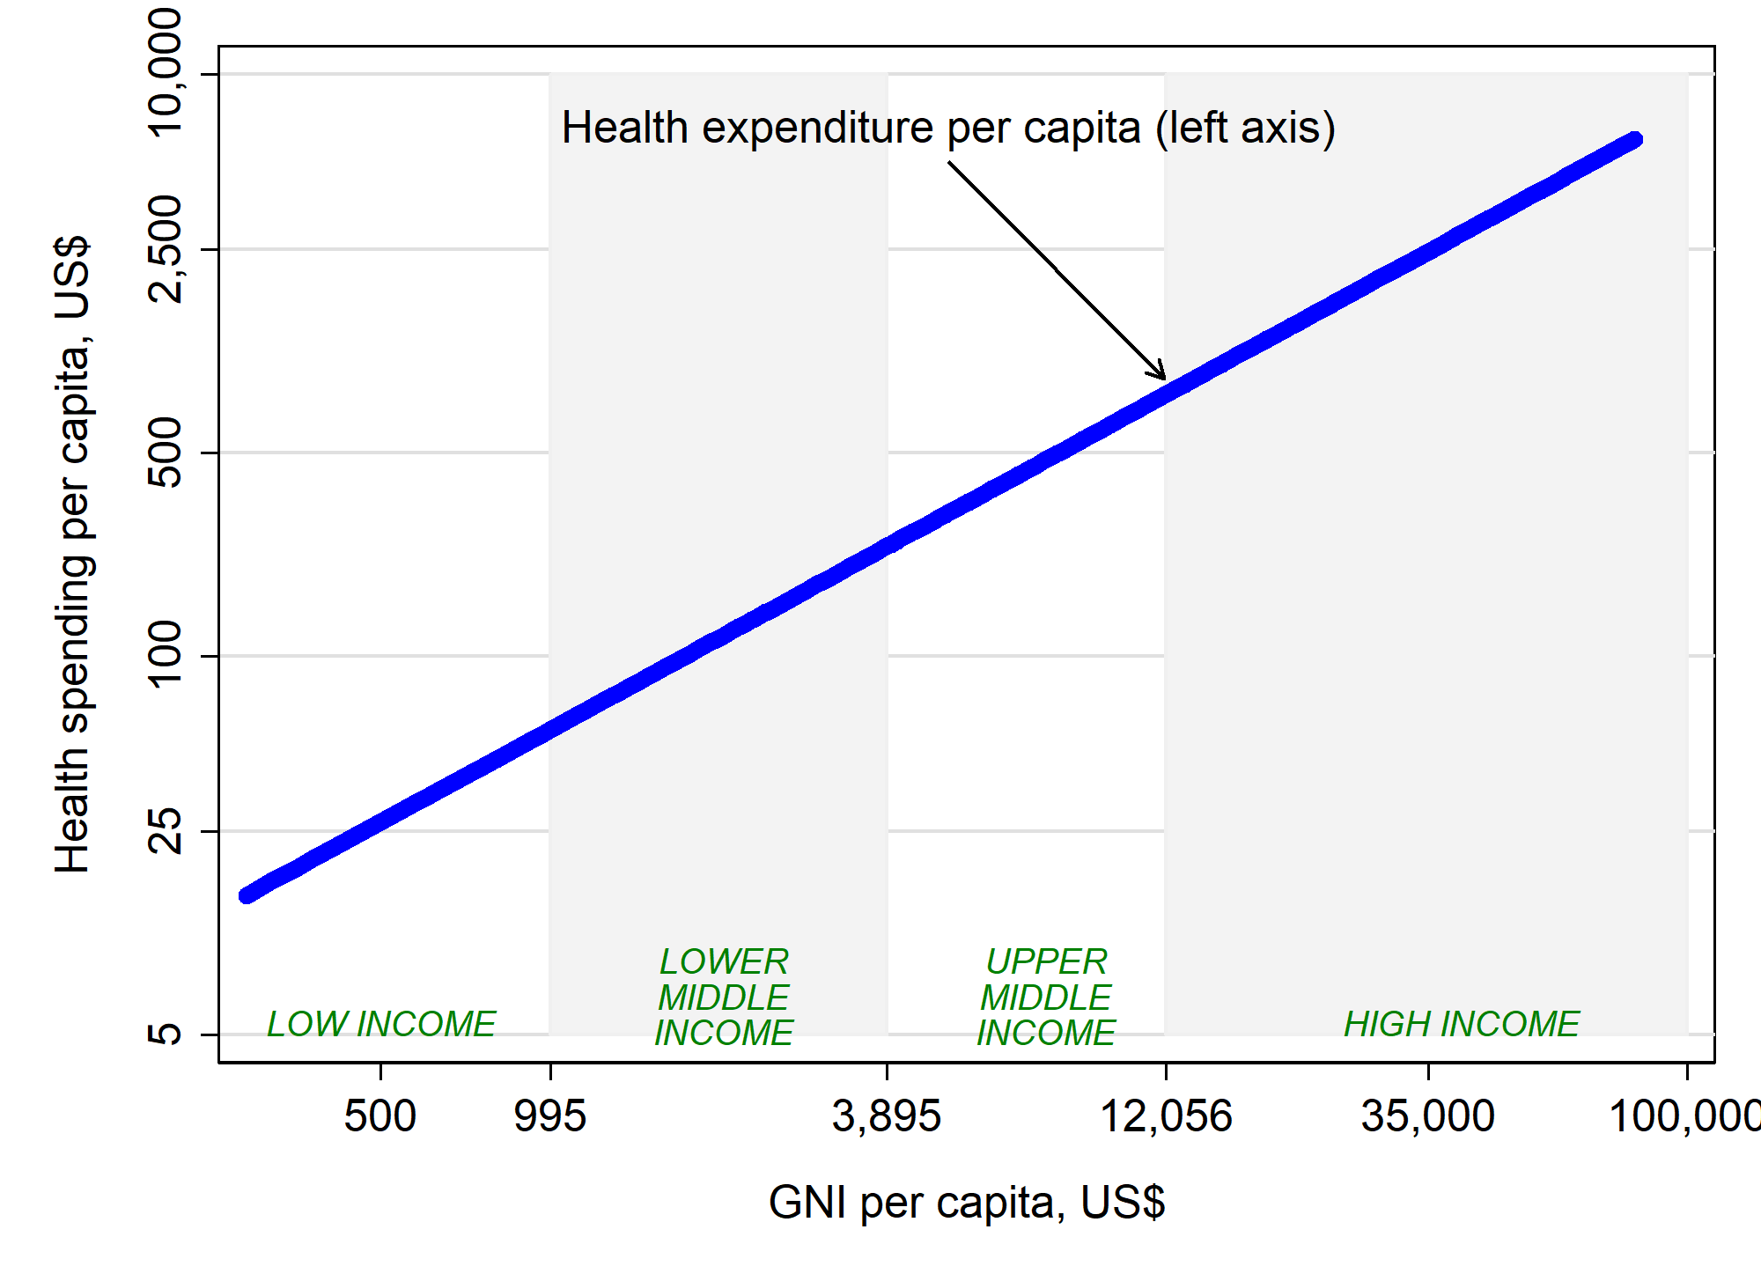
“Health Financing Transition”
Notes:
This is a stylized model and shows that on average, as country income increases, health expenditure per capita also increases…
In some LMICs there is also a subtransition away from development assistance (DAH)
But of course there is a great deal of variation and countries move through these transitions at different speeds.
The point is that there is a dual challenge……Most LMICs need to increase spending to expand coverage……
And in the next 3-4 years…

Slide 14
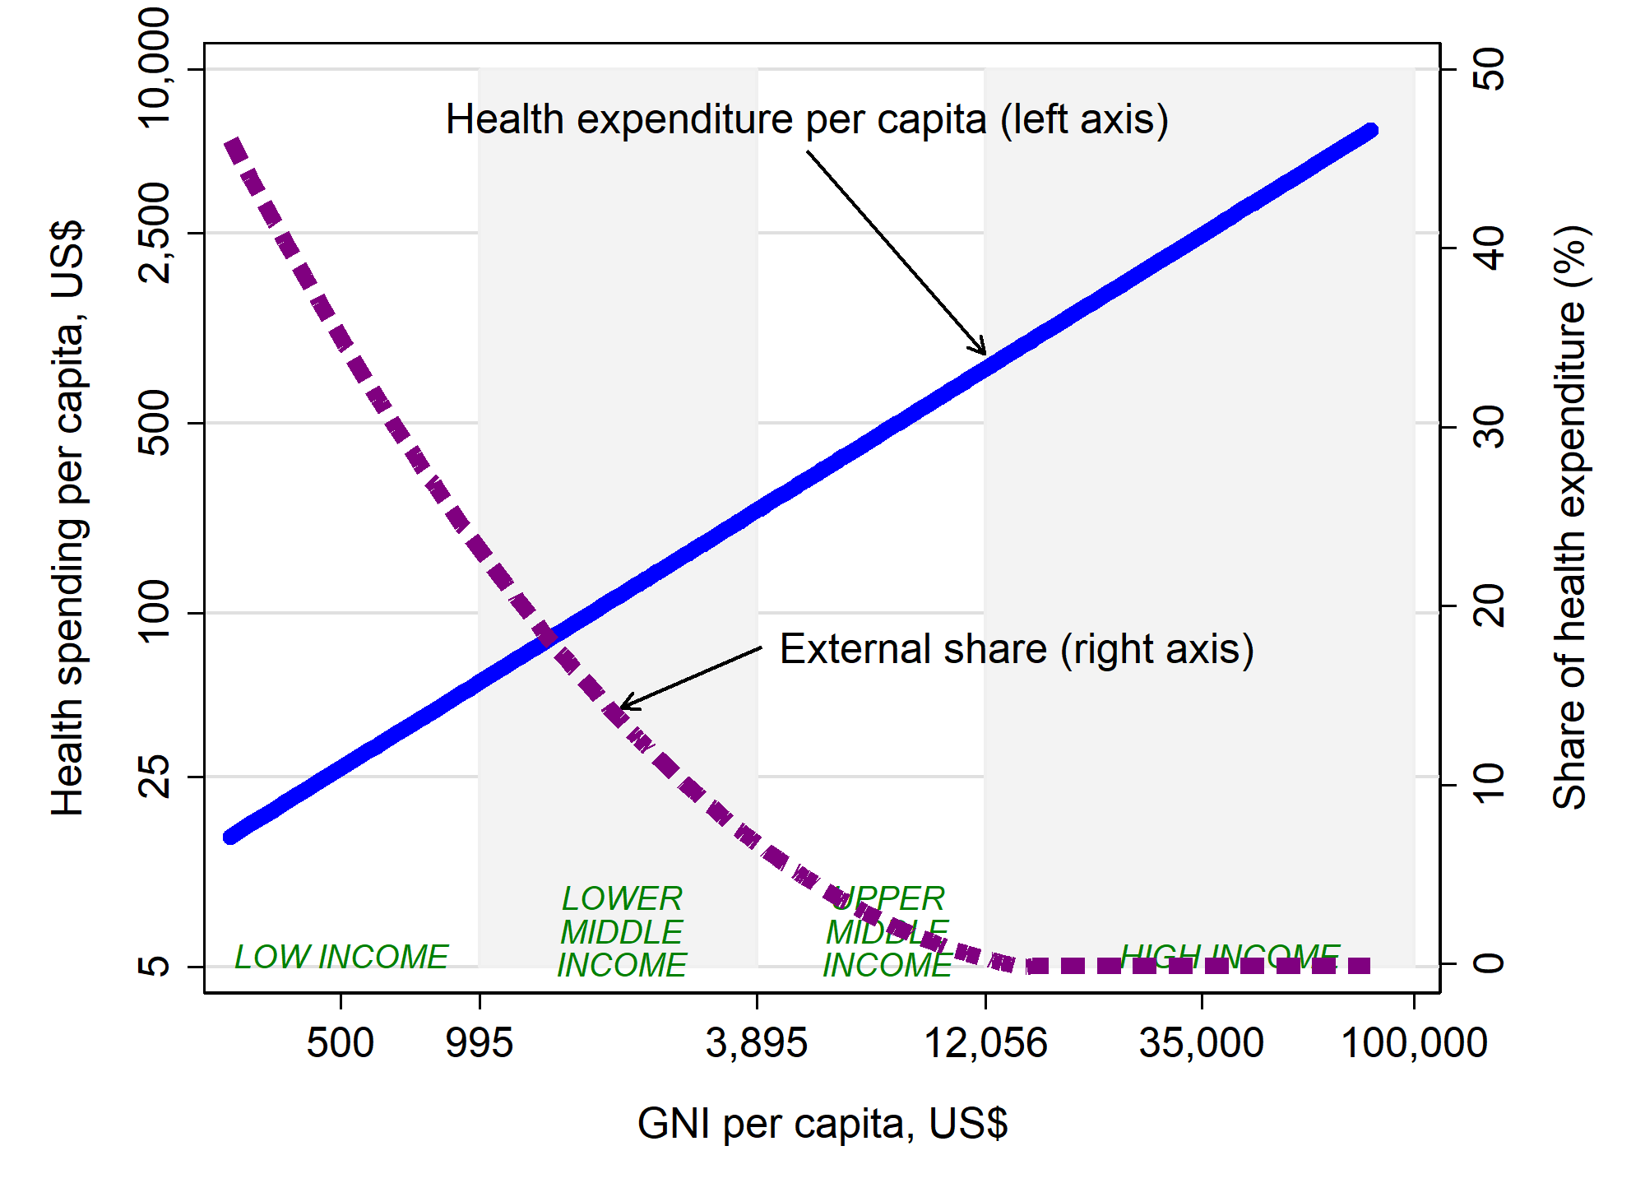
“Health Financing Transition”

Slide 15
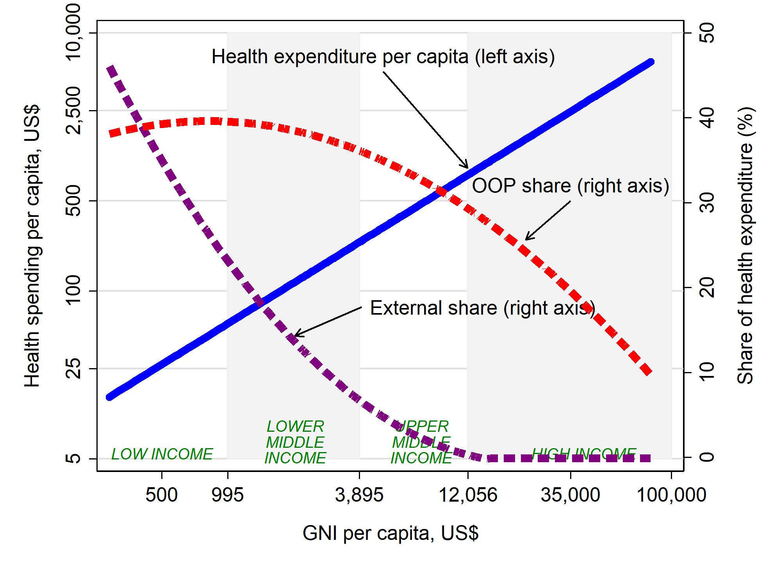
“Health Financing Transition”
Notes:
In the next 3-4 years, 35 countries are expected to transition out of Gavi, Global Fund, IDA and support from other partners.
At the same time, countries need to expand coverage of quality services to more people and ensure financial protection.
As countries become wealthier, they lose access to external financing, creating challenges and opportunities.
Most UMICS have already transitioned….with some exceptions

Slide 16
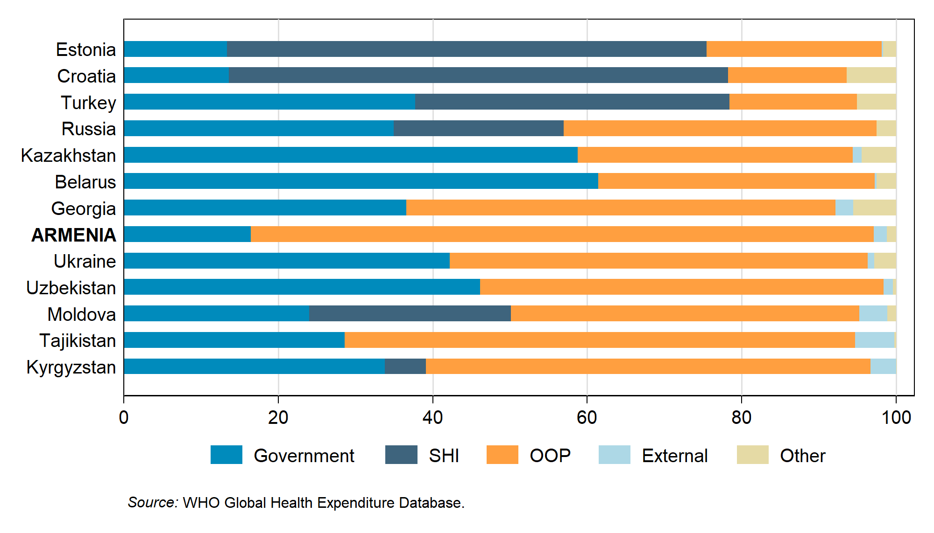
But there is variation across countries in composition of financing
Current health expenditure, 2016 (in order of GNI pc)
Armenia:
Only 17.4% of health spending from domestic public
1.3% from external
AND 80.3% from OOP
Notes:
But in Armenia development assistance for health accounts for only 1.7% of current health spending.
. Does that make transition easy?
Countries ability to weather the transition depends on many factors, including countries’ ability to mobilize public, prepaid, pooled resources
High levels of dependency on donor assistance can also make the transition more difficult
However, transition presents both financing and programmatic challenges

Slide 17
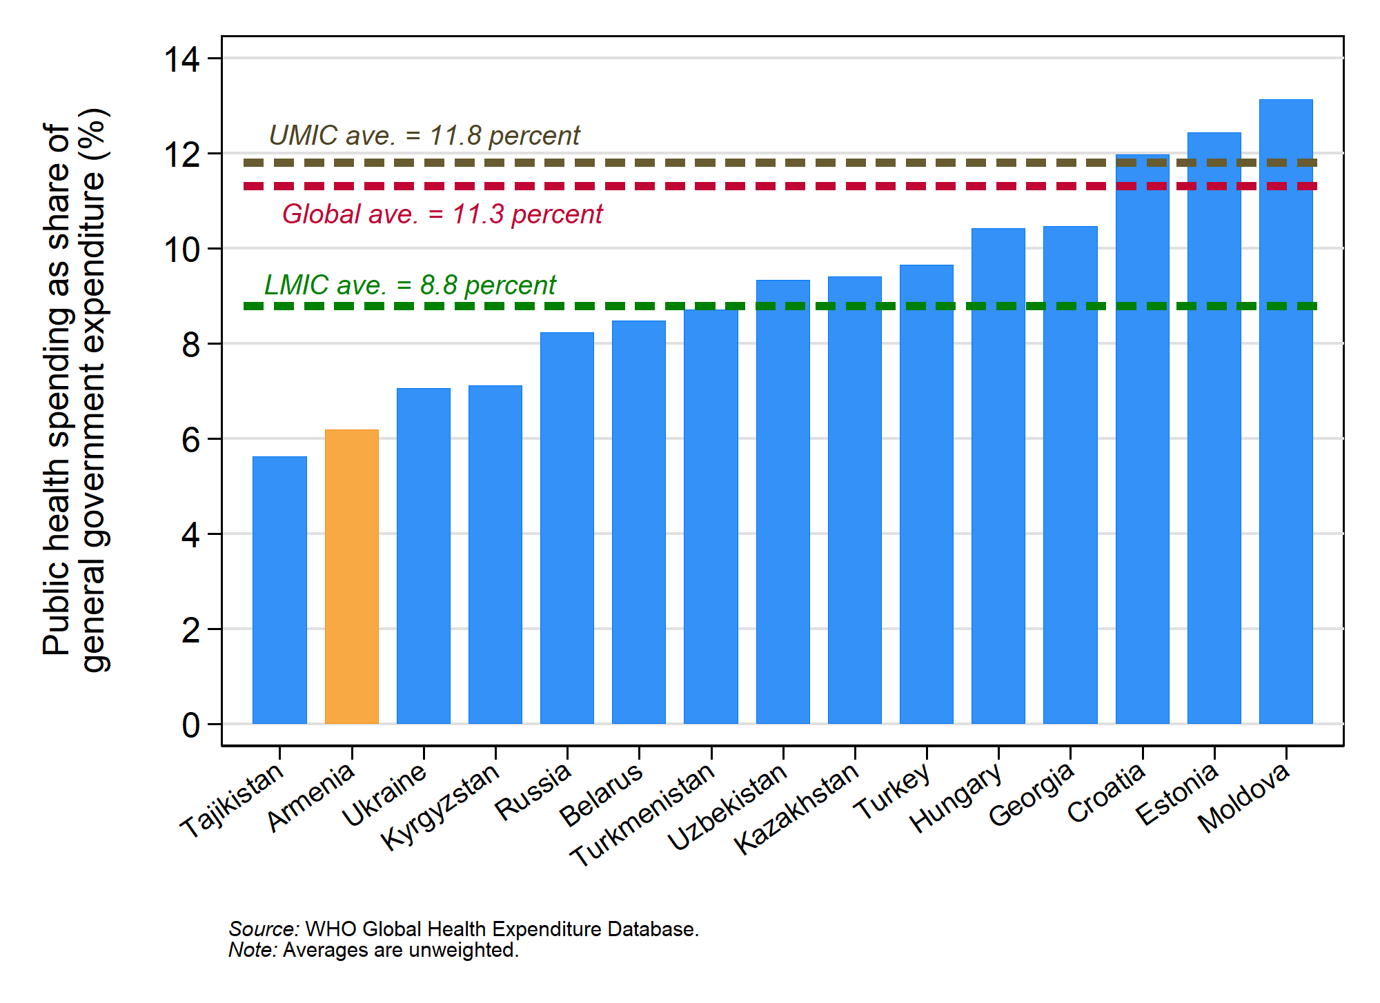
Variations in Prioritization for Health

Slide 18
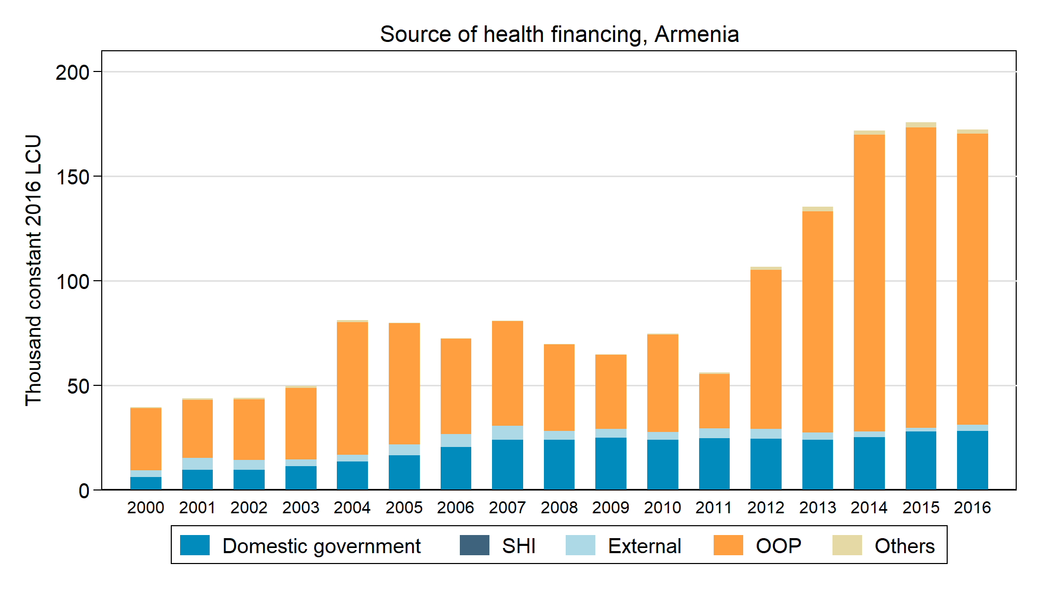
Armenia has not followed the empirical trend
Notes:
: domestic government has stagnated; OOP has grown

Slide 19
How to not get “lost in transition”?
Shares of total health expenditure, external financing and OOP $ USD per capita
Demographic transition
Epidemiological transition to NCDs
Establishment or expansion of SHI
Strategic purchasing
Decentralization
Notes:
Make sure to point out this shift toward SHI…
- Dual challenge - summarizing
Who finances delivery to children…

Slide 20
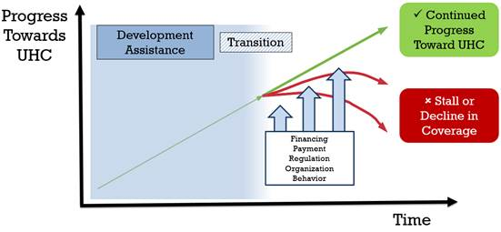
As donors transition, governments will need to consider how they can sustain the gains and continue making progress to UHC
Flagship Framework

Slide 21
What are the top two transition issues in Armenia?
Please refer to the handouts on eligibility and transition if necessary
Write your response on a paper

Slide 22
Key messages
The transition from development assistance in Armenia brings forth many challenges for maintaining the gains achieved with development assistance.
Health sector reforms towards UHC present opportunities but special attention needs to be given to ensure the health system adequately plans for these transitions
Countries experience a “health financing transition” whereby total health expenditure rises and the share of health expenditure from prepaid, pooled sources increases as country income rises. Armenia has not followed this trend and has high out-of-pocket spending.
The demographic and epidemiological shifts in Armenia will place increased pressure on the economy and the health system that justify the need for higher public spending
Notes:
This demographic shift and other societal factors suggest that Armenia will have to reduce its reliance on OOP health spending and increase public health financing in order to sustain and improve population health outcomes and achieve UHC.

Slide 23
Outline
1
Review transitions affecting health
Understand why “paying attention” to transitions is essential for making progress towards UHC
2
Discuss challenges and opportunities faced by transition from development assistance
3

Slide 24
Many of the programs that have benefitted from external support are also “tracers” to measure countries’ progress to UHC
Preventive/Promotive:
Access to modern contraceptives
Antenatal care (ANC) coverage
Skilled birth attendance rates
DTP3 coverage + MCV2
Non-smoking rates
Access to improved water sources
Access to improved sanitation
Treatment:
Diabetes treatment coverage
Hypertension treatment
TB cases detected and cured
People with HIV receiving ART
Financial Protection:
OOP spending as share of household consumption
Household impoverishment due to OOP expenditure
24
Notes:
EMPHASIZE DEFINITION OF UHC – EFFECTIVE COVERAGE (QUALITY) AND FINANCIAL PROTECTION…
Programs are part of UHC and not separate…..however, often viewed as separate because they have separate funding streams…….
Need to think differently about these……

Slide 25
Transition is not just about replacing resources
Financial implications of transition
How to continue financing priority programs?
How to mobilize prepaid, pooled funds to UHC?
How to ensure the financing of priority programs remains sustainable in health reforms?
Often there are ways of using funds more efficiently
Other implications of transition (“programmatic”)
How to take on or integrate key functions that have been supported by donors?
How to strengthen the system towards UHC?
How to ensure systems reforms favor priority programs?
Often there are opportunities to integrate or mainstream but options need to be assessed
Notes:
Transition is not just about replacing resources – it’s about doing things differently.
in reality, not such a clear distinction…..procurement could be considered programmatic – but huge impact on financing…
HR may be programmatic – capacity – but purchasing a key financing function……provider payment etc.
For the purpose of this course we won’t try to differentiate…..
Question about replacement is not as simple…..
Often this is called programmatic sustainability
- Often donors support functions in parallel

Slide 26
Donors support more than just financing…..
Human rights and gender equality
Last-mile interventions
Human resource support (training, direct contracting, per diems, top-ups)
Advocacy and citizen engagement
Procurement, logistics and supply chain
Quality control (e.g., service delivery, procurement)
Data and M&E systems; funding for regular data collection
Demand generation/
community mobilization
Program management and oversight
Attention to key issues: Meetings, M&E, targets
Interventions to address structural drivers of HIV risk
Evidence generation and decision-making
Notes:
It’s the donors that bring this type of support…
(criminalization,stigma, discrimination, etc.)

Slide 27
Why is it important to sustain health outcomes achieved with development assistance?
Public health considerations
Disease burden of key diseases still high (e.g., HIV; TB) in key and vulnerable populations
Ethical and equity considerations
Donors often fill gaps to improve equity (e.g., providing services to the poor; key and vulnerable populations)
Economical considerations
Prevention and disease control reduces system cost of achieving UHC
Maintaining coverage may be harder without external support
Donors support chronic conditions (e.g. HIV) – ethical implications of not continuing treatment
Not sustaining gains could lead to higher cost due to outbreaks; spikes in epidemic
Healthy population = Fundamental building block of a country’s workforce and economy
Notes:
Despite improvements in providing HIV prevention and treatment to people living with HIV, few countries have fully scaled up access among key populations:
Economics: prevention is cheaper than treatment…..recent studies in Armenia about the impact of introducing the rotavirus vaccine on reduced hospital admissions
A study by Ozawa et al (2016) found that the return on investment of investing in 10 vaccines was 16 times greater than the costs using a cost-of-illness approach and 44 times greater than the cost, when using a full-income approach

Slide 28
Armenia has made good progress on immunization coverage, BUT….
With Gavi support since 2001, Armenia has introduced many new vaccines and maintained high coverage
BUT new risks pose a threat to immunization, e.g., vaccine hesitancy
How to address?
Notes:
For example, vaccine hesitancy movement in providers – how to address through purchasing reforms and provider payment?
Coverage rates for 2017:
While the government deserves much credit, it has also benefitted from Gavi support since 2001 ($6.6 million)
(e.g., low spending on health limits sustainability; anti-vaccination movement threatens demand for immunization)

Slide 29
Treatment coverage rates for priority programs are similar to coverage rates in the region, BUT
New HIV and TB infections have declined
But new HIV infections have risen among seasonal workers to Russia and other countries
Armenia is one of 18 countries in the WHO European Region with the highest burden of TB and multidrug-resistant TB (MDR-TB)
Notes:
The question is….how to sustain these coverage rates and continue to make progress…..there are financial and programmatic implications
Source: WHO TB Country Profile, and Global Health Observatory data repository (WHO) , latest data available
https://www.who.int/tb/country/data/profiles/en/
http://apps.who.int/gho/data/view.main.23300?lang=en

Slide 30

What do you think are the two major issues for transition from development assistance in Armenia?
Notes:
Does this mean these programs should not be prioritized? No……very different situation without support from donors…
PRIORITY PROGRAMS
(no longer “protected” by donors),
Careful consideration is needed to work out the details

Slide 31
Outline
1
Review transitions affecting health
Understand why “paying attention” to transitions is essential for making progress towards UHC
2
Discuss challenges and opportunities faced by transition from development assistance
3

Slide 32
Financing and governance: Challenges and opportunities

Slide 33
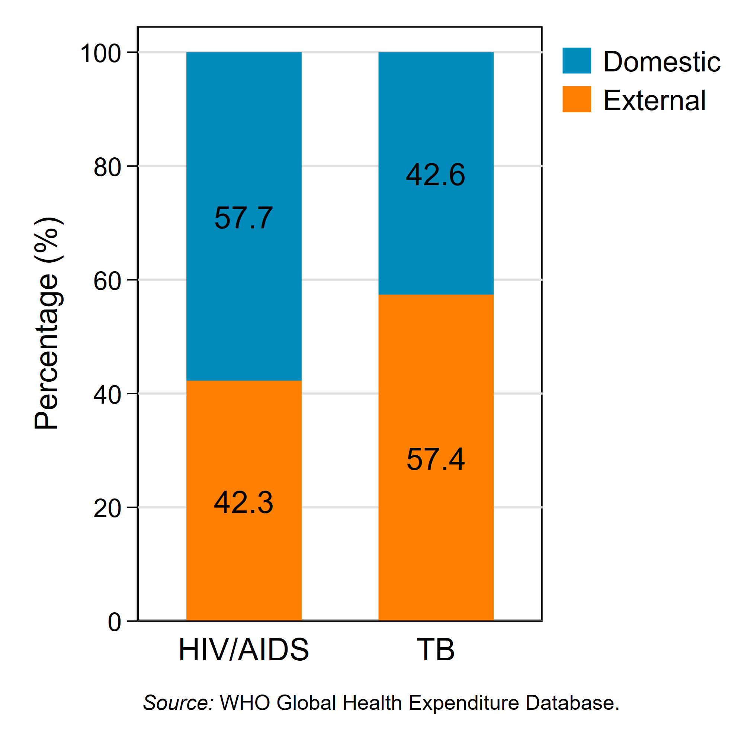
Development assistance for health in Armenia accounts for a small share of current health expenditure….BUT
Estimated Funding from Domestic vs. External Sources in Armenia, 2016
..a large share of program expenditures
And 100% of HIV prevention among key and vulnerable populations!
Source: WHO, Global Health Expenditure Database, 2016 funds, Accessed in 2019
Notes:
But external financing accounts for roughly one half the funding for HIV and TB programs
Some functions funded by donors cannot easily be taken over by government due to legal, regulatory, political etc.
Source: Global Health expenditure data base
In upper middle income countries, GF invests 100% of its financing to support key and vulnerable populations.
KVP
Injecting drug users (IDUs)
Men-who-have sex with men (MSM)
Female sex workers (FSWs) and;
Other vulnerable populations

Slide 34
The transition of financing from Gavi support in Armenia has been successful to date
Gavi invested $6.6 million from 2001-2018
Much of this support has been to support the introduction of new vaccines, (Hepatitis B, Pentavalent, Pneumococcal, Rotavirus, Inactivated Polio Vaccine and HPV) that are now fully financed by government
Immunization service delivery is embedded in primary health care and financed by government resources
Notes:
18 years – roughly 370 K per year… -
Core of financing transition of gavi is already past – now more about how to sustain a high performing program with new challenges including health reform, vaccine hesitancy….. And without external support….- prioritization against NCDs – for example….HPV is a prevention of NCDs…..
Very different kind of transition….but does not mean can continue to achieve those high coverage rates…

Slide 35
The Government of Armenia has demonstrated strong commitment to immunization historically
Spending on immunization has been protected even in the face of stagnant health spending
Even when the health budget was cut by 7% from 2017 to 2018, immunization spending decreased only marginally (by 0.5%)
During this time, government spending on immunization increased from 0.6% to 2.1% of health budget, while health’s share of government financing remained stagnant
MoF and MoH have agreed that calls for funds for vaccines and injection supplies be released for procurement (via UNICEF) by April every year
Notes:
The overall budget for vaccines (and immunization) has been relatively small share of overall gov budget for health
But also because even in the face of budget c
Government budget for health remained stagnant (6.1% of government budget in 2012; 7.3% in 2016; and 6.1% in 2018)
uts, the government has prioritized immunization.
The Gavi model for transitions has been praised for having a clear process. However, the context for Gavi is much simpler: It uses economic indicators only with a cut-off of $1,580 GNI per capita. The Global Fund and other donors work across a broader range of economic contexts and a range of diseases. It is also true that governments are far more willing to take up child immunization than they are certain types of HIV programs such as promoting human rights for drug users and men who have sex with men.
Also just many good examples .

Slide 36
As countries transition their purchasing functions, responsibilities for financing priority programs will need to be carefully considered
For example, will Armenia shift towards a single purchaser? Multiple purchasers?
How and where to finance:
Vaccines?
TB and HIV drugs ? (Currently benefit from pooled procurement)
Primary health care
Immunization service delivery (PHC + immunization-specific expenditures, e.g., supply chain, campaigns, etc.)
TB services: may also be transitioning from hospital-based to community based model
HIV treatment: for key populations?
NCDs: which preventive measures? Which treatment?
Notes:
Vaccines – in most LICs and LMICs this function stays with the MOH…. UNICEF is also an option even after transition from development assistance
Netherlands, Estonia (and probably other Bismarck systems) are ring fencing vaccine (not immunization) financing in MoH budget.
Immunization
TB serviainability of historically dependent programs will be addressed under this system, e.g. if PHC will receive a capitation budget from SHI – would this cover delivery of vaccines to the population and in what way? So we need to specifically mention this in the slides.

Slide 37
Responsibility for priority programs in countries
Countries | Immunization services | HIV testing + treatment | TB treatment | NCD services | Financing of vaccines | Procurement of HIV/TB drugs
Armenia* | MOH | MOH + donors | MOH + donors | Varies by group | MoH | MoH
Kyrgyz Republic | MHIF | MHIF | MHIF | MHIF | MoH/Gavi | MoH
Vietnam | MOH | MOH + donors (recent inclusion in SHI) | MOH + donors + SHI | SHI | MOH | Global Fund (MOH but transitioning to SHI)
Indonesia | State guarantee via MOH (but included in JKN provider cap) | Mix of MOH, SHI (JKN) and donors | Mix of MOH, SHI (JKN) and donors | SHI | MOH | Global Fund
Ghana | MOH with plans to move to NHIS | Mix of MOH, NHIS and donors | Mix of MOH, NHIS and donors | SHI | MOH/Gavi | Global Fund
Estonia | SHI (NHIF) | SHI (NHIF) | SHI (NHIF) | SHI (NHIF) | MoH | MoH (with plan to shift to SHI)
There are different organizational models to cover different parts of the priority programs:
Notes:
As moving to SHI……se variation..some programs remain with MOH while others go with insurance scheme….often immunization
Even if service delivery is financed through insurance scheme, vaccines usually remain with central government
- in all these countries, vaccines have remained with MOH….global public good
For drugs it varies….really depends…..
Ghana: responsibility is there, but actually most financing coming from NHIA…..only hav ea BP of what not to include – implicit – not explicit
Vietnam: Health insurance law of 2014, preventive services not included. Curative care – so immunization paid for through MOH – not paid through capitation to providers of VSS. Revised benefit package now includes HIV services
Estonia: ARVs and drugs for TB procured centrally by Ministry of Socail Affairs and distributed to health care providers to disseminate free of charge to patients with TB or HIV/AIDS.
Plan is to consolidate drug procurement under EHIF to reduce fragmentation and to integrate historical vertical programs
(HITs, 2019)

Slide 38


Roles and responsibilities for immunization need to be clearly defined to prevent “falling through cracks”
Indonesia: Immunization not included in JKN but covered by capitation; providers not aware
Individuals and providers are sometimes unclear on entitlements and funding sources for immunization services for insured vs uninsured, which could affect access for the uninsured.
Funds for immunization services are also part of the capitation payment to primary care providers under JKN (including immunization) but confusion among local governments and providers can result in capitation payments being used only for curative care.
Ghana: Immunization falling through cracks
A growing share of immunization is now paid through the NHIS but not as an explicit benefit
Lack of clear delineation of roles and responsibilities between MoH and NHIA for budgeting, planning, and procurement of vaccines
Little discretionary budget remaining to finance operational costs (99% to human resources)
Reduced funding for cold chain, outreach, etc. means missed opportunities to increase coverage and equity
Notes:
Therefore you have many districts with very low coverage in indonesia –
What incentives do you provide to local governments? Providers?
Critical expenditure –
Reallocated to nurses
- not clear where this sits from a budgetary perspective who pays? When? MOH and NHIA arguing over who should pay…..
Not clear responsibility..
Also, dependency on other donors and gavi hss… even for per diems….

Slide 39
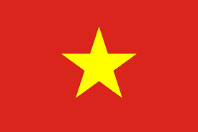
Many countries have incorporated HIV services into Social Health Insurance, but careful planning is needed
Vietnam:
To plan for transitions from PEPFAR and Global Fund, government integrated outpatient HIV treatment facilities into public health system, with funding primarily through SHI
Expanded population and service coverage (from 40% PLHIV to 80%)
Prime Minister issued a critical Decision (# 2188) to require full enrollment of PLHIV in SHI and government subsidizes their premiums
Procurement of ARV drugs paid for by government but transitioning to SHI
Notes:
Needed to think about sustainable financing – insurance was the obvious choice b/c this effort to insurance
HOWEVER, challenges…..not all PLHIV enrolled – so subsidized premium.
Procurement of arv subsidizing scheme?
On the other hand…..immunization not likely to be incluced

Slide 40
Service delivery challenges and opportunities

Slide 41

Bosnia and Herzegovina: Vaccine financing was not enough
Successful transition of financing for vaccines BUT
Insufficient investment in primary health care led to limited funding for outreach or the purchase of consumables, safety boxes, cold chain equipment, maintenance, and staff training
Insufficient coverage of training for health care workers on new introductions led to insufficient knowledge of injection safety and waste management
Coverage dropped from 95% in 2007 to 75% in 2017
A strong primary health care system is a critical factor affecting sustainable immunization

Slide 42

Lao People’s Democratic Republic: Transition presents opportunities to improve quality/efficiency of service delivery
Gavi and other donors support 70% of immunizations offered through outreach;
Incentives offered to workers through per diems potentially crowd out fixed-site service delivery/↑ cost
Integrated outreach reforms promote greater efficiency:
Improve targeting of integrated outreach for remote areas
Improve quality at fixed sites
Notes:
Cost = 50 dollars per child: transportation; vaccine carriers; per diem……- can provide
Part of the reason may be that 70% of immunization take place through outreach….
Important to note that the answer is not just to fix it:
P-DLI5. Number of villages in Zones 2 and 3 with health centers in which Integrated Outreach Sessions are conducted at least four times during the year
P-DLI-8:Number of Immunization Target Districts that have increased their coverage of Pentavalent 3 and measles and rubella immunization

Slide 43

Transition challenges are often more about figuring out how to reorganize
Key and vulnerable population groups get the services they need for a sustainable response
Key and vulnerable population groups get the services they need for a sustainable response
Provider
CHW
CHW
SRs/SSRs (CSO)
Health clinics/hospital (private or public)
?
Health clinics/hospital (private or public)
PR (Gov or NGO)
Funding source
Domestic public and private resources
Domestic public and private resources
Global Fund
(and other donors)
PRESENT RESPONSE WITH GF SUPPORT
FUTURE RESPONSE WITHOUT GF SUPPORT:
43
Notes:
Based on the TERG evaluation and other studies, one of the main risks that transition from Global Fund bring is the disruption of programmes that address the needs of KVP. It is not just because of the levels of funding available and how it is prioritized but also because GF model plays a particular role in shaping how programmes are delivered.
Most countries in region experience increasing burden of NCDs (and some are transitioning from development assistance)
Many opportunities to to integrate care through frontline services (and away from “hospital-centric” care to “patient-centered” care
But community-based interventions and NGOs will be essential
Requires strengthening information management, governance, financing and purchasing, outreach and community health.
WBG support……integrating across levels o
prevents fragmentation; increases continuity of care and quality
f care but also need to bring disease programs in

Slide 44
Government of PNG absorbs positions supported by Global Fund
In many countries, transferring capacity (and often personnel) may be a challenge
Notes:
This may be similar to the M&E team in Armenia, which is paid by the global fund…..
What are the challenges – may not be as simple as paying them – have to bring them onto payroll, are salaries aligned with public sector workers? Are there opportunities for task shifting or mainstreaming M&E functions?
Constraints of civil service positions ; salaries…
Several positions have been created and funded by Global Fund during the grant period.
These positions are essential for continued disease control
Govt of PNG is expected to absorb these positions once the grant is closed.
Are there any programmatic constraints to taking on these functions? (approval of payroll; changes in the pay structure, etc.?)
Example in south Africa: decided to drop a cadre of health care worker…may be opportunities to integrate or task-shift.

Slide 45
Equity and protection of human rights: challenges and opportunities

Slide 46
The experience of Serbia
https://www.youtube.com/watch?v=eRH6WQltl00&hl=en%5FUS&version=3
Notes:
Serbia’s MOH did not fund continuation of KVP prevention services, and is confronting a spike in HIV epidemic among MSM. The GF Board approved exceptionally an allocation of funding, conditional on Serbia setting up a contracting mechanism for these services and committing to co-fund and eventually take over these services.

Slide 47

Service provision for key populations may be at risk due to transition
Romania: After first transition of HIV support from Global Fund, the government failed to adequately prioritize harm reduction programs, leading to a spike in HIV infections among people who inject drugs (PWID)
from 1.1% prevalence in 2009 to 6.9% in 2012 to 53% in 2013
There is policy or legislation that supports a mechanism for the government to fund NGOs (grant or contract) for some activities, but it does not currently include provision of harm reduction services
Notes:
Romania transitioned from HIV support in 2010 but will transition from TB in 2018.
- In Romania, other sectors use NGOs but the Ministry of Public health
NGOs/CSOs often play a critical role in reaching the most vulnerable but policy, legal, regulatory, or operational issues may threaten sustainability of these programs
So for example, the Min of Labor can fund NGOs but the Min of PH cannot.
Macedonia: Services for people who inject drugs, sex workers and MSM were delivered by NGOs, contracted by GF; MOH started a registration process for NGOs to make them eligible to receive funding for HIV prevention.
needle and syringe exchange programs for PWIDs; services for sex workers; counseling and preventive services for MSM for people who inject drugs, sex workers and MSM were at risk when GF transitioned
Indonesia
Few local governments allocate budgetary funds to hire CSOs, but recent training, awareness raising, changes in regulations enables contracting with NGOs (important for sustainability after GF transitions in 2024)
As there is an understanding that public money is not allowed for CSO operational costs, currently the most common mechanism is by paying salary/honoraria for CSO personnel in joint government-CSO implemented activities. There are a few local governments that allocate budgetary funds to hire CSO individuals or use social assistance grants to implement activities and, in some cases, provide in-kind assistance to support CSOs. Although, in practice, other fund channeling mechanisms exist, such as Swakelola (sometimes categorized as similar to force account) and Bantuan Pemerintah (grants beyond social assistance context), they are either unfamiliar to central or district implementers, or seen as too risky to be implemented (Appendix 3).
Romania: HIV prevalence among PWID in Romania in 2009 was estimated to be 1.1%, rising to 6.9% in 2012. The prevalence then shot up to an estimated 53% in 2013 - likely as a consequence of the end of Global Fund support to NSP - before falling back somewhat to 21.4% in 201416. Among a sample size of 809 PWID in 2013, HIV prevalence was 49.2%, up from 24.9% in 2012 (n=398)17, however civil society organisations (CSOs) believe this figure to be higher18. In
ICASO case study: http://icaso.org/wp-content/uploads/2016/10/Romania-case-study.pdf
Ask – what are the challenges in Armenia?

Slide 48
Procurement and supply chain: challenges and opportunities

Slide 49
Access to timely and affordable supply essential for program efficiency in Gavi transitioning countries
Many countries use a mixed procurement method, procuring at least in part through UNICEF
Some countries face barriers to continuing UN procurement
73% of transitioned or transitioning countries have identified at least one red flag in their current procurement practices (Cernuschi et al, 2018)
Gavi transition plans support training on procurement methods, improving registration procedures, improving government understanding of UNICEF procurement processes, etc.
Notes:
Many countries utilize a mixed-procurement method to ensure timely access to affordable supply, procuring Gavi-funded vaccines and occasionally other routine vaccines through UNICEF Supply Division (SD)
Some countries face barriers to continuing UN procurement due to national legislation requiring local procurement of vaccines

Slide 50
In some countries, laws and regulations can “make or break” countries’ ability to access affordable prices for commodities
At least one country in Eastern Europe/Central Asia (similar process in other regions):
MOH procures almost all vaccines directly (even those that could be lower cost using an MOU with UNICEF Supply Division)
Small market size and concerns about quality and cold chain requirements led to a shift to direct procurement of vaccines through UNICEF Supply Division
MOH regulations allowed for pre-payment of vaccines but only if made in same fiscal year as delivery of vaccines
Price per dose reduced considerably; $2 million dollars saved in first year and reinvested in immunization program, including upgrades to cold chain equipment
Notes:
Makes it difficult for ministries to procure vaccines and injection supplies through UNICEF Supply Division.
Issue in Georgia is more around capacity and global fund is helping to strengthen proper functioning of procurement and supply chain…….
Vietnam also uses procurement agent….
Example of barriers:
Patent protection
Quality assurance/capacity for quantification/forecasting
Laws that prevent competition/favorable pricing
Verticalized system with duplication…..but likely set up that way for a reason – to get around some of the problems of the government system. So part of building sustainability to better prepare for transition is figuring out where to integrate – but also what reforms need to take place. This could be reforms of procurement, legal framework, drug reg….decentralization of procurement to provinces.
+ Key point is that the “symptom” / service delivery feature that is trying to be changed is procurement and supply chain. But underlying this are various health system building blocks: procurement system, but also legal framework, drug regulation, and the context of decentralization of procurement to provinces.
.
Armenia: Has overcome some regulatory challenges to procuring TB drugs but previously could not participate in international tender

Slide 51

In some countries, laws and regulations can “make or break” countries’ ability to access affordable prices for commodities
Georgia: Procurement and supply of HIV and TB drugs is now managed by the National Center for Disease Control (NCDC)
Provision in the State Budget Law enables NCDC to procure through pooled procurement to ensure quality and best price; but other countries don’t have this provision
Notes:
Makes it difficult for ministries to procure vaccines and injection supplies through UNICEF Supply Division.
Issue in Georgia is more around capacity and global fund is helping to strengthen proper functioning of procurement and supply chain…….
Vietnam also uses procurement agent….
Example of barriers:
Patent protection
Quality assurance/capacity for quantification/forecasting
Laws that prevent competition/favorable pricing
Verticalized system with duplication…..but likely set up that way for a reason – to get around some of the problems of the government system. So part of building sustainability to better prepare for transition is figuring out where to integrate – but also what reforms need to take place. This could be reforms of procurement, legal framework, drug reg….decentralization of procurement to provinces.
+ Key point is that the “symptom” / service delivery feature that is trying to be changed is procurement and supply chain. But underlying this are various health system building blocks: procurement system, but also legal framework, drug regulation, and the context of decentralization of procurement to provinces.
.
Armenia: Has overcome some regulatory challenges to procuring TB drugs but previously could not participate in international tender

Slide 52
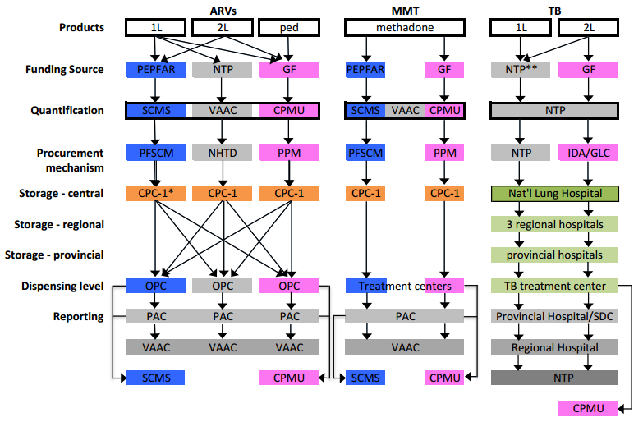
Vietnam: Transition also provides an opportunity to reduce duplication and fragmentation of procurement and supply chain systems
Source: Options for Integrating Procurement and Supply Chain Systems for ARVs, Methadone, and anti-Tuberculosis Drugs in Vietnam, USAID Health Financing and Governance, 2014
Notes:
Protectionist laws favor domestically produced pharmaceuticals, which limit competitive pricing
Verticalized system with duplication…..but likely set up that way for a reason – to get around some of the problems of the government system. So part of building sustainability to better prepare for transition is figuring out where to integrate – but also what reforms need to take place. This could be reforms of procurement, legal framework, drug reg….decentralization of procurement to provinces.
+ Key point is that the “symptom” / service delivery feature that is trying to be changed is procurement and supply chain. But underlying this are various health system building blocks: procurement system, but also legal framework, drug regulation, and the context of decentralization of procurement to provinces.
.

Slide 53
Demand-side challenges and opportunities

Slide 54
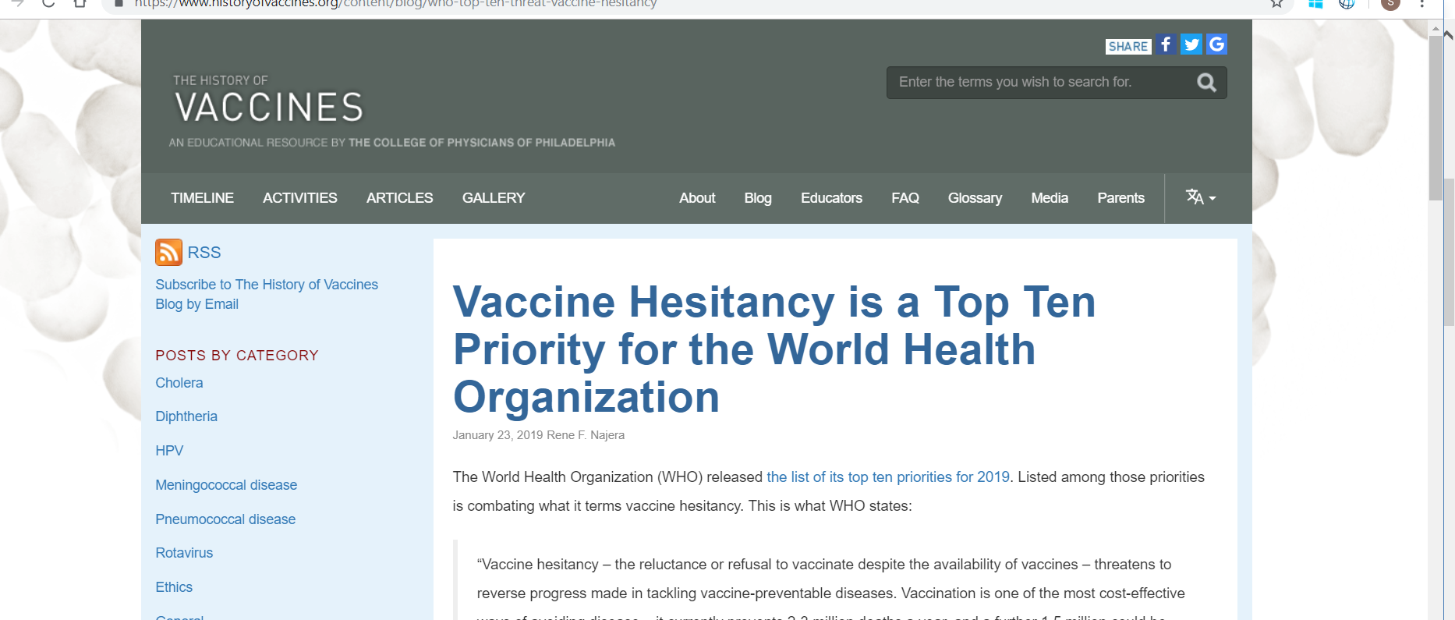
Vaccine hesitancy – one of the top ten threats in global health in 2019 according to WHO
Notes:
Globally: the example of measles
300% increase in the number of cases this year, partly due to vaccine hesitancy
Countries in the region - introduction of HPV:
In Kazakhstan, HPV vaccine caused clusters of anxiety-related adverse events following immunization
Transformed into widespread psychogenic / hysteria reactions that created negative publicity
In Romania and Kazakhstan, the MoH had to cancel the HPV program and destroy the vaccine.

Slide 55
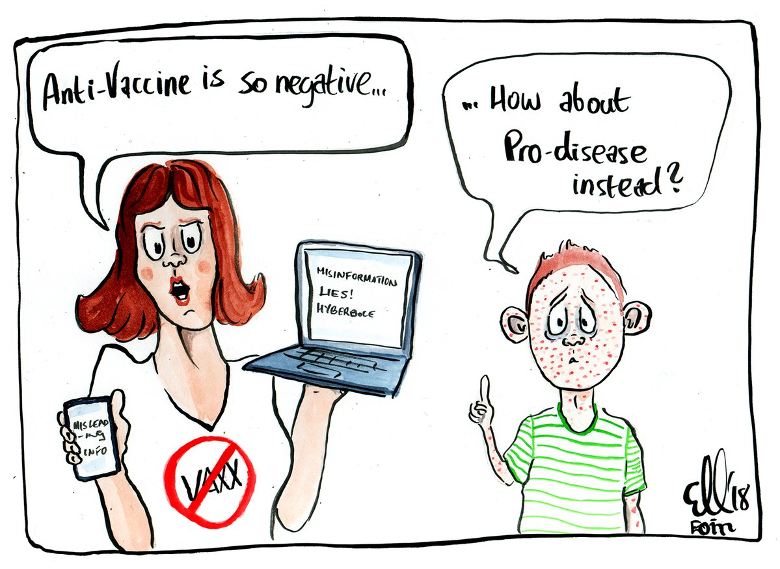
How to address vaccine hesitancy?
All control knobs needed:
Financing
Payment
Organization
Regulation
Behavior
Notes:
Read Rialda’s summary
Countries in the region - introduction of HPV:
In Kazakhstan, HPV vaccine caused clusters of anxiety-related adverse events following immunization
Transformed into widespread psychogenic / hysteria reactions that created negative publicity
In Romania and Kazakhstan, the MoH had to cancel the HPV program and destroy the vaccine.
Complacency, inconvenience in accessing vaccines, and lack of confidence have been identified by the WHO vaccine advisory group (SAGE) as key reasons for vaccine hesitancy.

Slide 56
Key messages
A key financing challenge facing transitioning countries is figuring out how to more effectively mobilize prepaid, pooled resources toward UHC
Even countries with low levels of development assistance face challenges transitioning from donor support because of the way support is delivered (concentrated in programs; used to finance programs that may require non-state actors)
Transitions often accompany health sector reforms, requiring governments to assess which service delivery and governance models are optimal for sustaining gains while moving to UHC
Policy, legal, regulatory and external pressures often need to be overcome for a successful transition
The Flagship framework is one tool to help countries navigate multiple transitions while moving to UHC
Notes:
E.g., planning and budgeting, procurement, regulation (NRA), management and supervision, data management, last-mile interventions, support for key populations, advocacy to overcome human rights barriers and restrictive legal and policy environments etc.

Slide 57




The road to UHC is paved with many transitions
Integration of priority programs
9
UHC
Low revenues
Low prioritization on health
Transition from external financing
10
High debt
8
Slowed GDP growth
Rising costs
$
4
Demographic transition
Inefficient use of resources
7
Epidemiological
transition
3
5
Disease
outbreaks
6
Weak PFM practices
Adaptation of graphic from freepik.com
https://www.freepik.com/free-photos-vectors/infographic
Notes:
What transitions are here?

Slide 58
….But if we navigate properly, we will get to our destination

Slide 59

Have your views changed about the transition challenges in Armenia?
Notes:
Don’t need to think about how you would address it….just brainstorm about what it is….

Slide 60
Contact information
Sarah Alkenbrack salkenbrack@worldbank.org
Toomas Palu tpalu@worldbank.org
Clementine Murer cmurer@worldbank.org
Santiago Cornejo scornejo@gavi.org

Slide 61
Recommended for your viewing pleasure: “An additional funding request”
https://www.youtube.com/watch?v=ceeS9ncv1hM
Notes:
Dialogue too often focuses on replacing resources, which often have substantial budget impact
Reframing to demonstrate return on investment is often essential
Demonstrating impact is essential during budget negotiations

